Slide 1
Security Over Compliance
Sarah Badahman
CEO/Founder, HIPAAtrek
www.hipaatrek.com
sarah@hipaatrek.com
314-272-2598

Slide 2
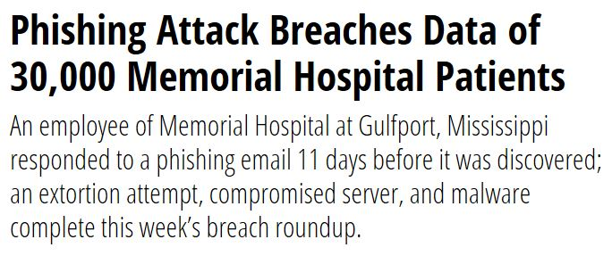
Notes:
For the first time, criminal hacking has surpassed human error as the main cause of healthcare data breaches
Costs healthcare as much as $6B!
As hackers become more sophisticated, it’s predicted that there will be a 125% increase in the number of intentional attacks over the next 5 years
More than 50% of respondents to a Ponemon Institute survey said their organization’s internal incident response teams were either understaffed or underfunded
Approx. 1/3 of respondents didn’t have any incident response plan in place whatsoever
Reveals the need for organizations in the healthcare industry to better protect themselves and their records from attack
Not only do data breaches affect an organizations’ reputation, legal, and financial perceptive, but also drastically impacts the real risk to an affected patient’s health. Loss of access to medical records can cause misdiagnosis, delayed treatment, incorrect prescriptions/diagnostic orders. Complete loss of those records is particularly harmful as patients can be poor historians of their own medical history.
40% of the health organizations in the study admitted that they had reported more than 5 breaches in just the past 2 years – accounting for more than 90 million records!

Slide 3
Hacking has surpassed all other breach types!
Most Attacked Locations
Most hacking events will affect more than one location
Most attacks are preventable with proper attention to security
Healthcare is the most attacked industry in the US
Attacks are coming from overseas as well as in country
Network Servers
EMR
Email
Desktop Computers
Laptops

Slide 4
Why Are We
Vulnerable?
Security Remains Minimally Addressed…WHY?
Not viewed as critical to patient care
Shortcuts to adoption of technology are culturally “OK” in healthcare
Budget – Tech is EXPENSIVE to adopt and maintain
Nontechnical vulnerabilities:
Ineffective/non-existent policies, procedures, standards, or guidelines
Notes:
Interruption of existing workflows are met with resistance
Belief that your hospital or clinic is too small to be targeted or breached
Assuming the cost of a potential breach will not outweigh the cost to implement the appropriate controls

Slide 5
Why Are We
Vulnerable?
Weak or Missing Security Measures Include…
Lack of Authentication
2-factor authentication
Weak password policies
Lack of Encrypted Data at Rest (Stored Data)
Use of insecure email
Free/personal email accounts
Shared email accounts
Unencrypted email
Access on mobile devices
Nontechnical vulnerabilities:
Ineffective/non-existent policies, procedures, standards, or guidelines

Slide 6
Why Are We
Vulnerable?
Weak or Missing Security Measures Include…
Lack of comprehensive inventory
Lack of basic security procedures
SSL/TLS on websites and applications transmitting PHI
Data backup/disaster recovery planning
Auditing and monitoring procedures
Nontechnical vulnerabilities:
Ineffective/non-existent policies, procedures, standards, or guidelines
Notes:
Use of outdated technologies
Training of staff on recognizing potential malware

Slide 7
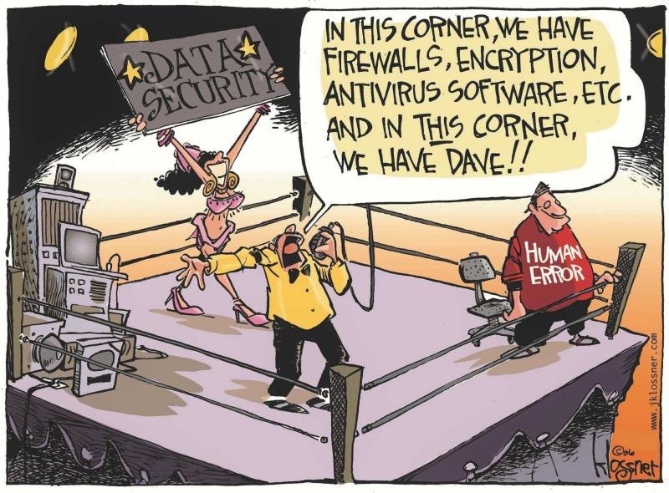
Treating Your Work Environment Like Your Home Environment
Computing habits
Browsing
Email
Social media
Physical security
Leaving unlocked and unattended
Leaving mobile devices in vulnerable areas
Security practices
Passwords
Firewalls
Audit procedures
Notes:
Common cybersecurity mistakes

Slide 8
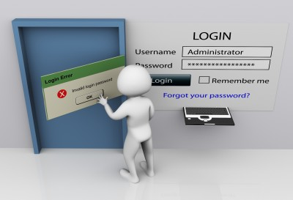
Ignoring Non-Technical Vulnerabilities
Physical security
Portable devices
Storage
Maintenance records
Employee
Training
Hiring
Terminating
Policies and procedures
More than just a binder
Third parties
Business Associate Agreements
Security assessment of third-party vendors
Technical
Vulnerabilities
Non-Technical
Vulnerabilities

Slide 9
The Best Defense: A Robust Security Program
Focus on security and compliance will follow

Slide 10
NIST Cybersecurity Framework
Notes:
HIPAA is NOT a Security Framework
OCR/HHS refer to NIST security framework
Need to up healthcare’s security game
Over 340 breaches reported so far in 2019
212 were Hacking/IT incidents

Slide 11
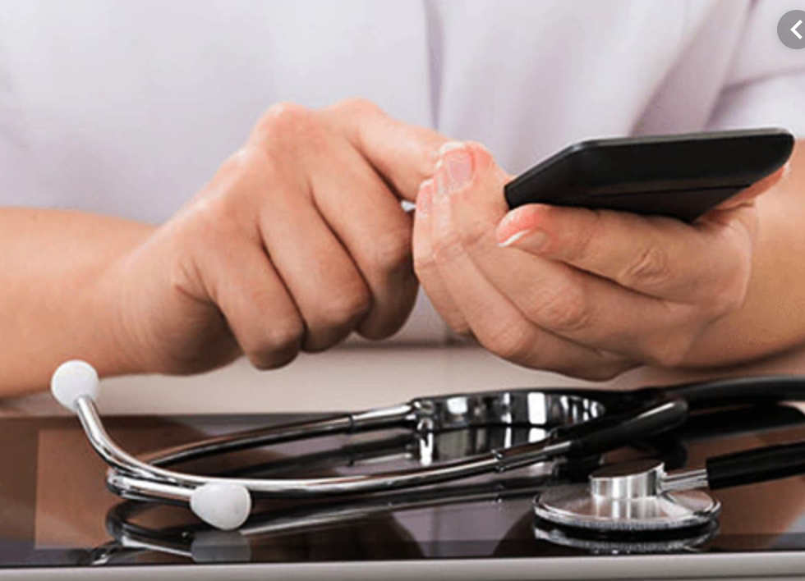
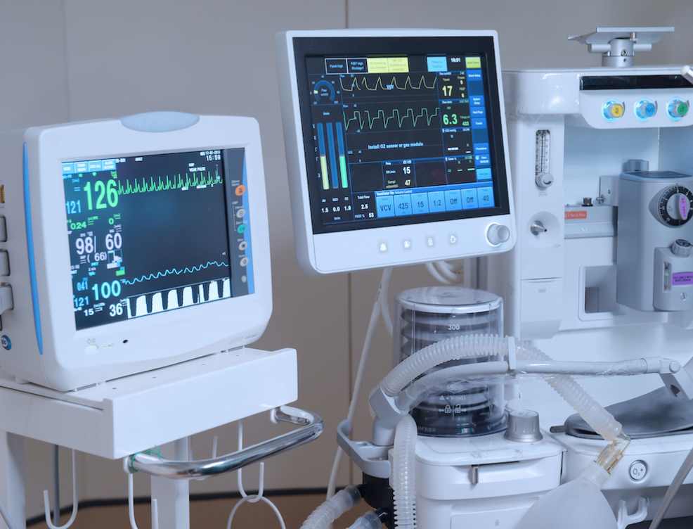
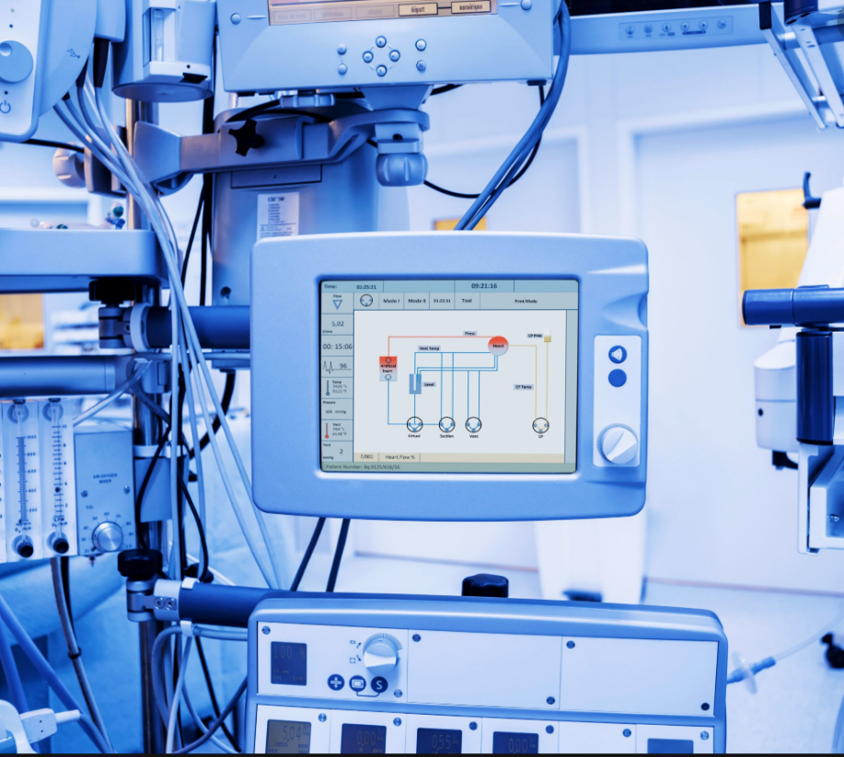
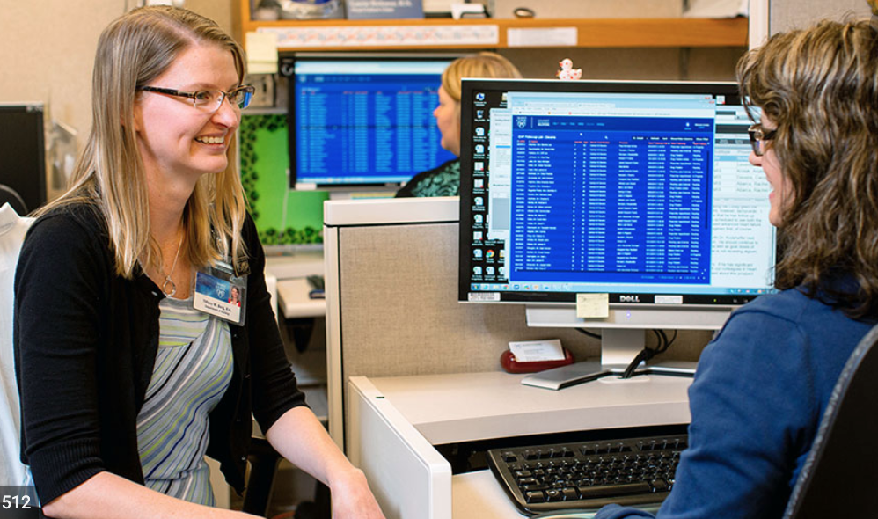
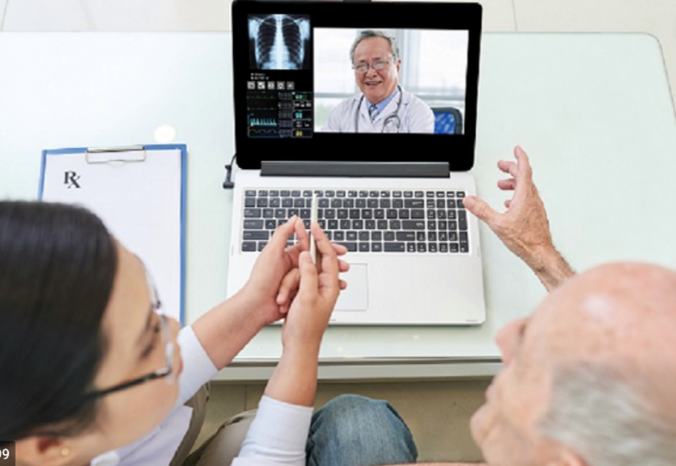
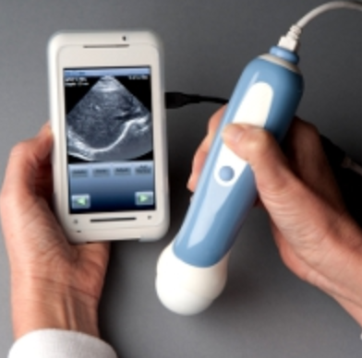
Cybersecurity must include all devices connected to the Internet or network
Notes:
Cybersecurity goes beyond your workstations and mobile devices.

Slide 12
Connected Devices Are a Growing Security Concern
Unsupported operating systems
Not considered in risk analysis/security evaluations
Do not support common security protocols
Unique user ID
2-factor authentication
Audit controls
Store rich ePHI
Easily breached with low likelihood of immediate discovery

Slide 13
Asset Management Action Steps
Identify ALL devices, workstations, mobile devices, and personal devices which access, store, or transmit ePHI
Identify ALL software that creates, accesses, stores, or transmits ePHI
Application and Data Criticality Analysis
Controls (policies, procedures)

Slide 14
Conduct a Security Risk Analysis!
GI Joe was right...
Scope the Assessment
Gather Information
Identify Realistic Threats
Identify Potential Vulnerabilities
Assess Security Controls
Assess Risk Impact
Assess Risk Probability
Document Findings
Develop and Implement a Risk Management Plan
TIP: Use a Multi-Disciplinary Approach
Notes:
Vulnerability: A flaw/weakness in system security procedures, design, implementation, or internal controls that could accidentally or intentionally be exercised and result in a security breach or violation of an organization’s security policies.
Threat: The potential for a person or thing to accidentally trigger or intentionally exploit a specific vulnerability.
Types of threats:
Natural
Human
Environmental
Where threats occur:
Information systems
Operating systems
Environment
Risk Probability: The likelihood that a threat could exercise a vulnerability.
Risk Impact: The effect on an organization if a vulnerability is exercised.
Impacted areas could include:
Availability of systems and/or data
Financial cost
Legal repercussions
Reputational harm
Controls: Safeguards to control, mitigate, or prevent a vulnerability from being exercised.
Safeguards include:
Policies & procedures
Processes to control/prevent threats exercising vulnerabilities

Slide 15
Risk Management Action Steps
Prioritize identified vulnerabilities
Create a project management plan for each vulnerability that will be mitigated
Use a multi-disciplinary approach to mitigation
Document EVERYTHING
Remember risk management is an on-going process

Slide 16
Access Control
Establish access
Modification of access
Review of access
Don’t forget PHYSICAL access
Minimum Necessary Rule
Notes:
The following are steps to take to protect your data

Slide 17
Encryption Practices
Encrypt data at rest
Full Disk encryption
Only effective on an unbooted computer. The second it's turned on, the encryption is no longer effective
May prove ineffective in most environments as workstations are rarely powered down when not actively being used
Files are not protected when moved as they are decrypted during the process
File Encryption
Stay encrypted regardless of where they are stored
As long as the file is ‘at rest’ the file is encrypted, even if the computer is booted
DON”T send unencrypted communications containing ePHI
Text
Email
Notes:
Most thefts involving portable devices are laptops that are unencrypted
Don’t forget to encrypt smart phones and tablets that store, transmit, access ePHI

Slide 18
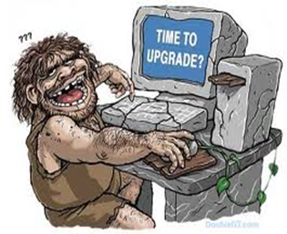
Information Systems Maintenance
Outdated technology costs the health industry $8.3B annually
Patch Management
Automate as much as possible
Assess Legacy Systems
Ignoring updates leads you vulnerable
Cleaning Machines
Temporary Files
Recycling Bins
Older Technology
Incompatible with newer softwares and patches
Prone to crash
Lost productivity/revenue
Higher prevalence of cyber attacks
Less likely to be supported

Slide 19
Early Detection Saves Data!

Slide 20
Detection Software
NEVER use home versions!
Keep libraries up to date
Review quarantines frequently
Disallow users from disabling
Ensure it can scan root folders
Scan email attachments
Scan websites
No Detection Software Catches 100%

Slide 21
Employee Training
Educate staff on recognizing a potential attack
Slow moving machines
Executable starts running
Pop-ups
Instruct them on what to do if they suspect an attack
Disconnect from the network
Unplug the workstation
Power off the workstation
THEN call IT
Notes:
Browser Toolbars not added by the user
Strange network patterns

Slide 22
Don’t Panic!
Assemble a multi-disciplinary task force
Contain the breach or attack
Assess severity and extent of the breach
Notification
Patients
Staff
Management
Document along the way
You will need this to avoid future breaches

Slide 23
Disaster Recovery Plan
Healthy data backup planning and processes essential
Recovery time objective
Recovery point objective
Application and Data Criticality Analysis
Test the process frequently!
Notes:
Contingency planning

Slide 24
Ransomware Response Plan
Do you have a plan specific to ransomware?
To pay the ransom or not to pay the ransom – that is the question!
FBI warns against paying the ransom
Many hospitals and clinics have been forced to pay
What will YOU do?
Have you simulated a ransomware attack?
Employee training on ransomware is NOT an option!

Slide 25
Your data is valuable. Your cybersecurity and compliance programs must protect them!

Slide 26
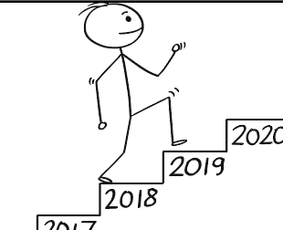
Compliance is a Journey
Compliance is a journey…NOT a destination!
Be sure to stay on top of all HIPAA requirements – many are ongoing tasks that must be completed daily, monthly, quarterly, or annually

Slide 27
About Our Sponsor: Throttlenet
Throttlenet is a management services provider with over 20 years of experience in providing IT and security services to the healthcare industry
Throttlenet believes that cookie cutter solutions belong in the bakery and not in healthcare environments. Throttlenet provides customized IT solutions.
Contact Chris Montgomery for more information:
314-227-2632
cmontgomery@throttlenet.com

Slide 28
sarah@hipaatrek.com
314-272-2600
Questions?
?
?
?
?
?
?
?
?

